Slide 1
Review of Linear Algebra
10-725 - Optimization
1/16/08 Recitation
Joseph Bradley

Slide 2
In this review
Recall concepts we’ll need in this class
Geometric intuition for linear algebra
Outline:
  Matrices as linear transformations or as sets of constraints
  Linear systems & vector spaces
  Solving linear systems
  Eigenvalues & eigenvectors

Slide 3


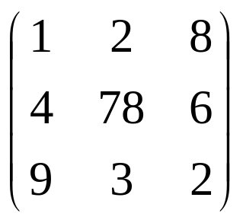
Basic concepts
Vector in R^{n} is an ordered set of n real numbers.
  e.g. v = (1,6,3,4) is in R⁴
  “(1,6,3,4)” is a column vector:
  as opposed to a row vector:
m-by-n matrix is an object with m rows and n columns, each entry fill with a real number:

Slide 4
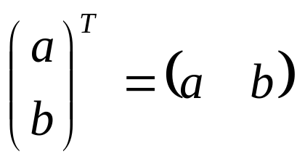
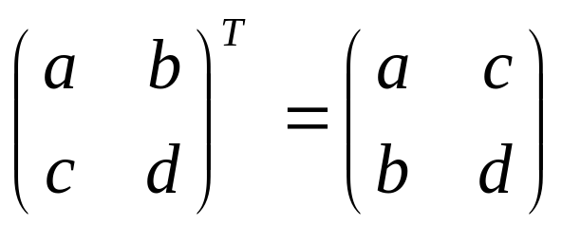
Basic concepts
Transpose: reflect vector/matrix on line:
  Note: (Ax)^{T}=x^{T}A^{T} (We’ll define multiplication soon…)
Vector norms:
  L_{p} norm of v = (v₁,…,v_{k}) is (Σ_{i} |v_{i}|^{p})^{1/p}
  Common norms: L₁, L₂
  L_{infinity} = max_{i} |v_{i}|
Length of a vector v is L₂(v)

Slide 5
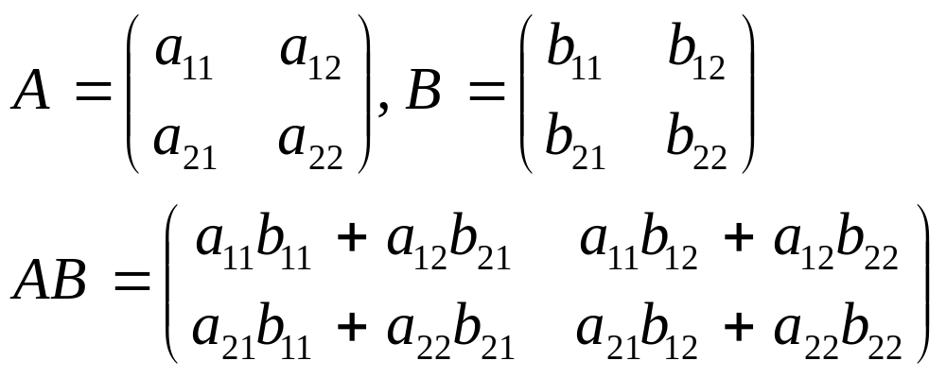
Basic concepts
Vector dot product:
  Note dot product of u with itself is the square of the length of u.
Matrix product:

Slide 6
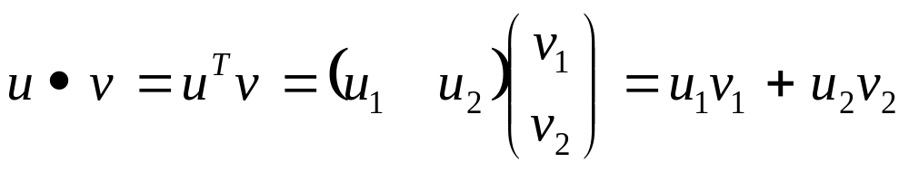
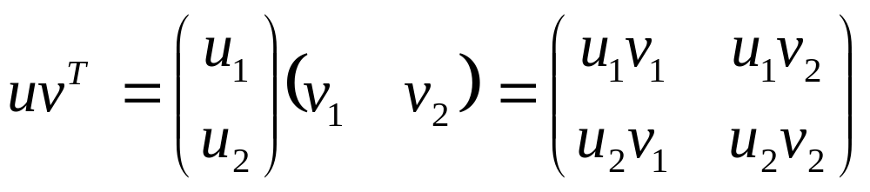
Basic concepts
Vector products:
  Dot product:
  Outer product:

Slide 7
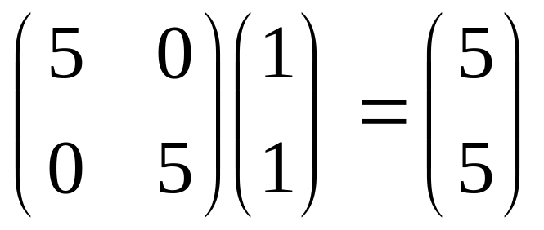
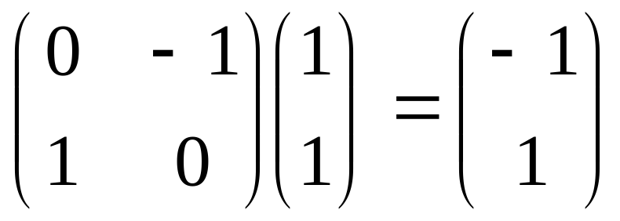
Matrices as linear transformations
(stretching)
(rotation)

Slide 8
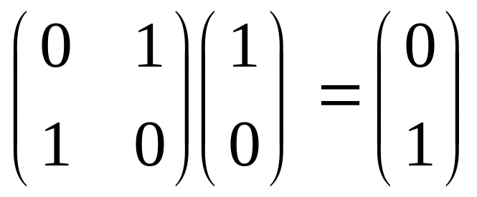
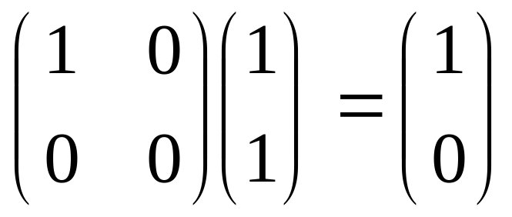
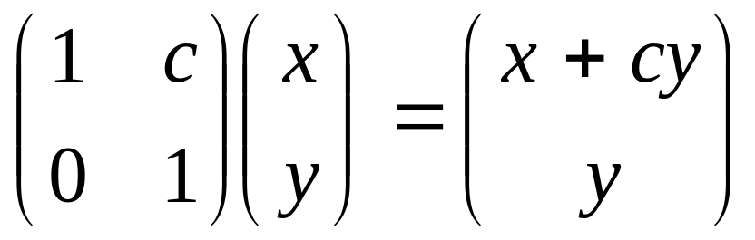
Matrices as linear transformations
(reflection)
(projection)
(shearing)

Slide 9
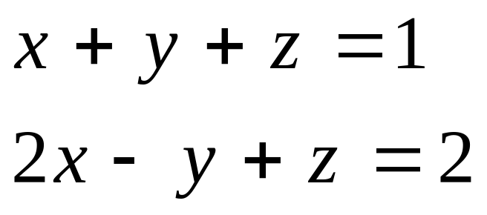
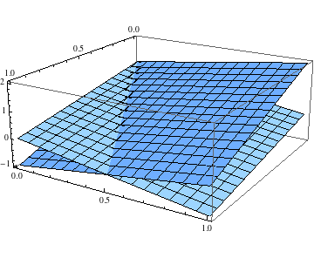
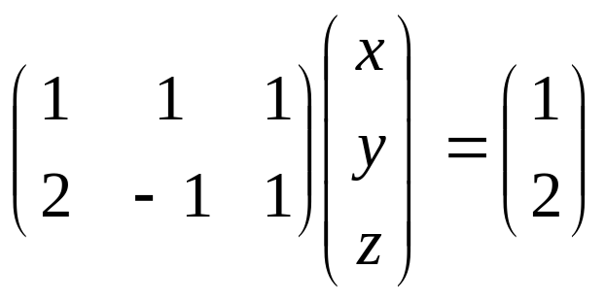
Matrices as sets of constraints

Slide 10



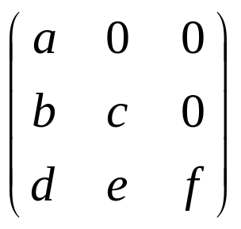
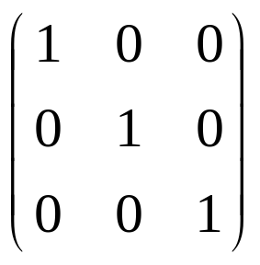
Special matrices
diagonal
upper-triangular
tri-diagonal
lower-triangular
I (identity matrix)

Slide 11
Vector spaces
Formally, a vector space is a set of vectors which is closed under addition and multiplication by real numbers.
A subspace is a subset of a vector space which is a vector space itself, e.g. the plane z=0 is a subspace of R³ (It is essentially R².).
We’ll be looking at R^{n} and subspaces of R^{n}
Our notion of planes in R³ may be extended to hyperplanes in R^{n} (of dimension n-1)
Note: subspaces must include the origin (zero vector).

Slide 12
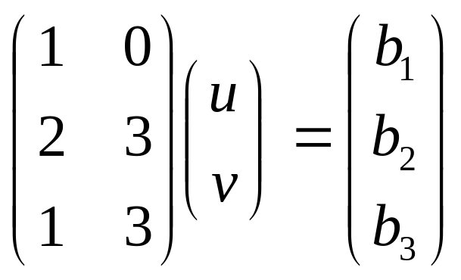
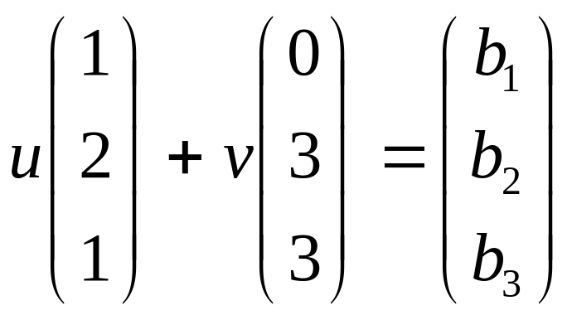
Linear system & subspaces
Linear systems define certain subspaces
Ax = b is solvable iff b may be written as a linear combination of the columns of A
The set of possible vectors b forms a subspace called the column space of A
(1,2,1)
(0,3,3)

Slide 13
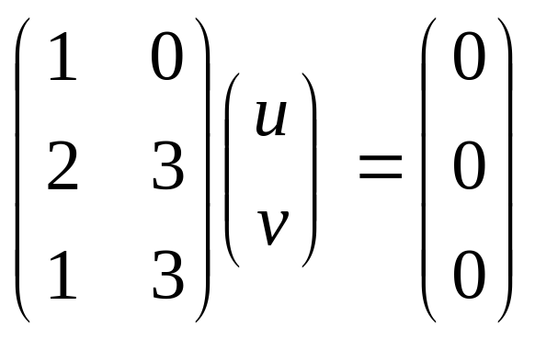
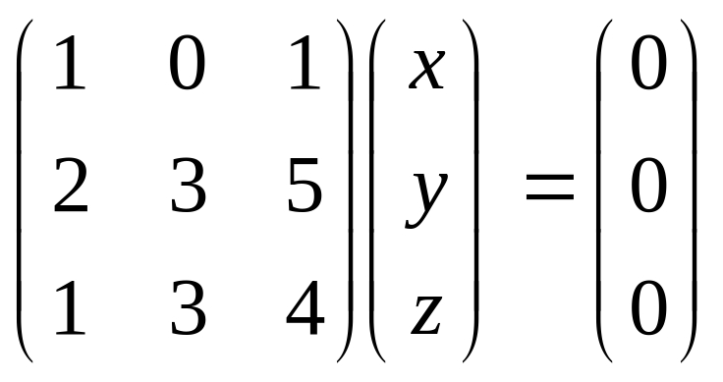
Linear system & subspaces
The set of solutions to Ax = 0 forms a subspace called the null space of A.
→ Null space: {(0,0)}
→ Null space: {(c,c,-c)}

Slide 14
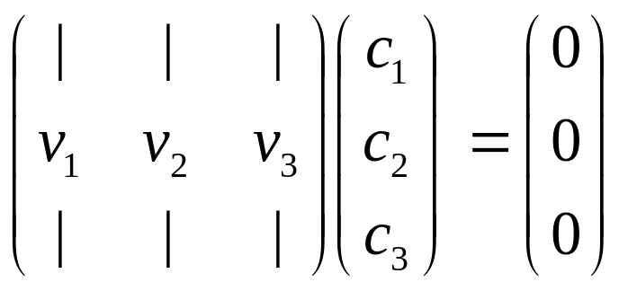
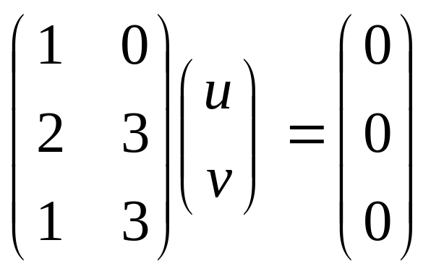
Linear independence and basis
Vectors v₁,…,v_{k} are linearly independent if c₁v₁+…+c_{k}v_{k} = 0 implies c₁=…=c_{k}=0
i.e. the nullspace is the origin
(2,2)
(0,1)
(1,1)
(1,0)
Recall nullspace contained only (u,v)=(0,0).
i.e. the columns are linearly independent.

Slide 15
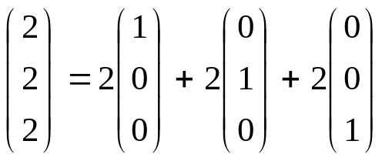
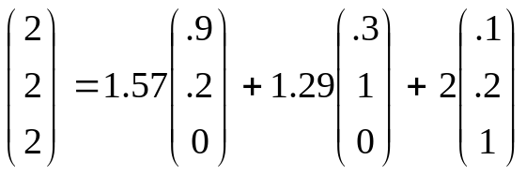
Linear independence and basis
If all vectors in a vector space may be expressed as linear combinations of v₁,…,v_{k}, then v₁,…,v_{k} span the space.
(0,0,1)
(.1,.2,1)
(0,1,0)
(.3,1,0)
(1,0,0)
(.9,.2,0)

Slide 16
Linear independence and basis
A basis is a set of linearly independent vectors which span the space.
The dimension of a space is the # of “degrees of freedom” of the space; it is the number of vectors in any basis for the space.
A basis is a maximal set of linearly independent vectors and a minimal set of spanning vectors.
(0,0,1)
(.1,.2,1)
(0,1,0)
(.3,1,0)
(1,0,0)
(.9,.2,0)

Slide 17
Linear independence and basis
Two vectors are orthogonal if their dot product is 0.
An orthogonal basis consists of orthogonal vectors.
An orthonormal basis consists of orthogonal vectors of unit length.
(0,0,1)
(.1,.2,1)
(0,1,0)
(.3,1,0)
(1,0,0)
(.9,.2,0)

Slide 18
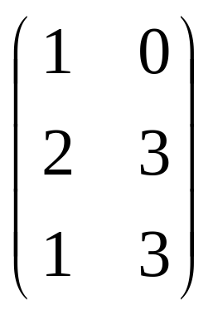
About subspaces
The rank of A is the dimension of the column space of A.
It also equals the dimension of the row space of A (the subspace of vectors which may be written as linear combinations of the rows of A).
(1,3) = (2,3) – (1,0)
Only 2 linearly independent rows, so rank = 2.

Slide 19
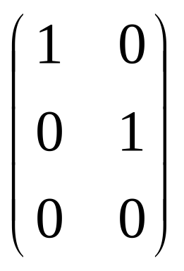
About subspaces
Fundamental Theorem of Linear Algebra:
If A is m x n with rank r,
  Column space(A) has dimension r
  Nullspace(A) has dimension n-r (= nullity of A)
  Row space(A) = Column space(A^{T}) has dimension r
  Left nullspace(A) = Nullspace(A^{T}) has dimension m - r
Rank-Nullity Theorem: rank + nullity = n
(0,0,1)
m = 3
n = 2
r = 2
(0,1,0)
(1,0,0)

Slide 20
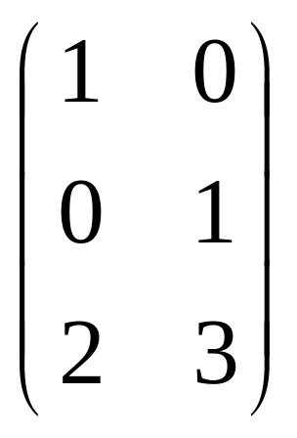
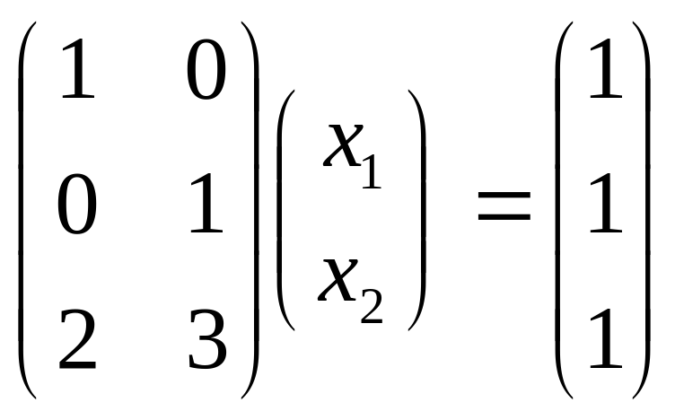
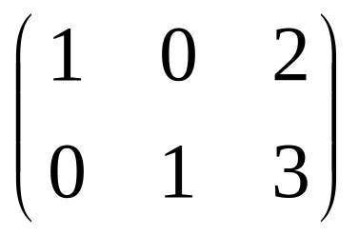
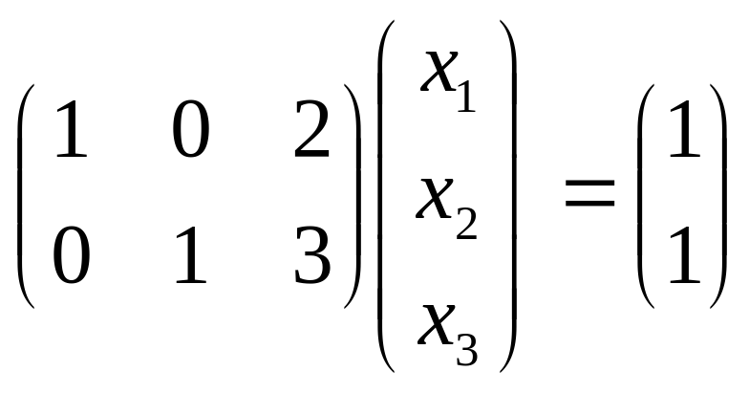
Non-square matrices
m = 3
n = 2
r = 2
System Ax=b may not have a solution (x has 2 variables but 3 constraints).
m = 2
n = 3
r = 2
System Ax=b is underdetermined (x has 3 variables and 2 constraints).

Slide 21
Basis transformations
Before talking about basis transformations, we need to recall matrix inversion and projections.

Slide 22
Matrix inversion
To solve Ax=b, we can write a closed-form solution if we can find a matrix A⁻¹
s.t. AA⁻¹ =A⁻¹A=I (identity matrix)
Then Ax=b iff x=A⁻¹b:
  x = Ix = A⁻¹Ax = A⁻¹b
A is non-singular iff A⁻¹ exists iff Ax=b has a unique solution.
Note: If A⁻¹,B⁻¹ exist, then (AB)⁻¹ = B⁻¹A⁻¹,
and (A^{T})⁻¹ = (A⁻¹)^{T}

Slide 23
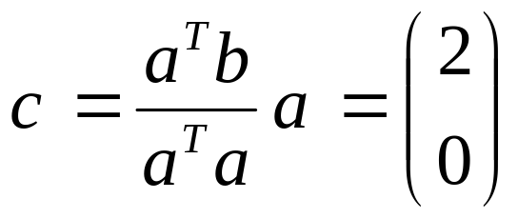
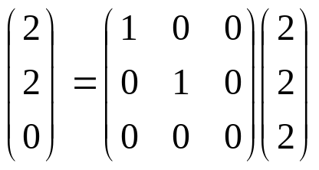
Projections
(2,2,2)
b = (2,2)
(0,0,1)
(0,1,0)
(1,0,0)
a = (1,0)

Slide 24
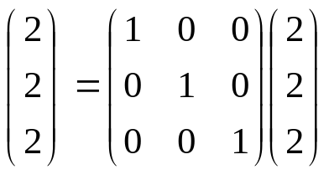
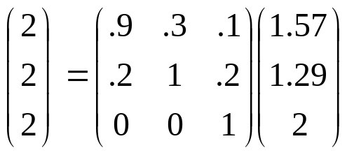
Basis transformations
We may write v=(2,2,2) in terms of an alternate basis:
(0,0,1)
(.1,.2,1)
(0,1,0)
(.3,1,0)
(1,0,0)
(.9,.2,0)
Components of (1.57,1.29,2) are projections of v onto new basis vectors, normalized so new v still has same length.

Slide 25
Basis transformations
Given vector v written in standard basis, rewrite as v_{Q} in terms of basis Q.
If columns of Q are orthonormal, v_{Q} = Q^{T}v
Otherwise, v_{Q} = (Q^{T}Q)Q^{T}v

Slide 26
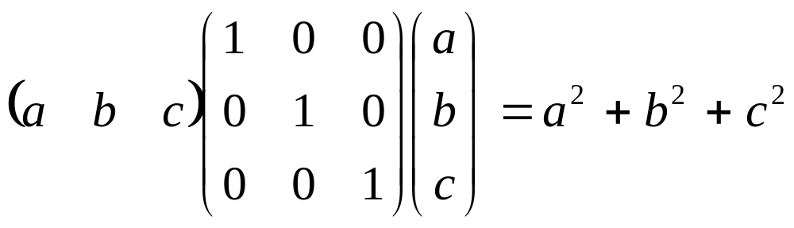
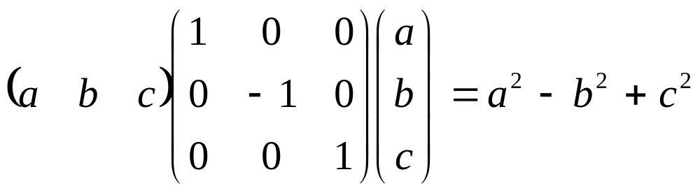
Special matrices
Matrix A is symmetric if A = A^{T}
A is positive definite if x^{T}Ax>0 for all non-zero x (positive semi-definite if inequality is not strict)

Slide 27
Special matrices
Matrix A is symmetric if A = A^{T}
A is positive definite if x^{T}Ax>0 for all non-zero x (positive semi-definite if inequality is not strict)
Useful fact: Any matrix of form A^{T}A is positive semi-definite.
To see this, x^{T}(A^{T}A)x = (x^{T}A^{T})(Ax) = (Ax)^{T}(Ax) ≥ 0

Slide 28
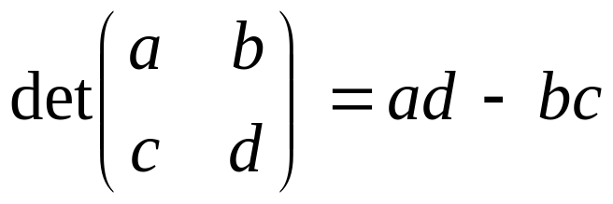
Determinants
If det(A) = 0, then A is singular.
If det(A) ≠ 0, then A is invertible.
To compute:
  Simple example:
  Matlab: det(A)

Slide 29
Determinants
m-by-n matrix A is rank-deficient if it has rank r < m (≤ n)
Thm: rank(A) < r iff
det(A) = 0 for all t-by-t submatrices,
r ≤ t ≤ m

Slide 30
Eigenvalues & eigenvectors
How can we characterize matrices?
The solutions to Ax = λx in the form of eigenpairs (λ,x) = (eigenvalue,eigenvector) where x is non-zero
To solve this, (A – λI)x = 0
λ is an eigenvalue iff det(A – λI) = 0

Slide 31
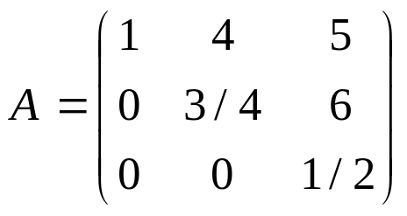
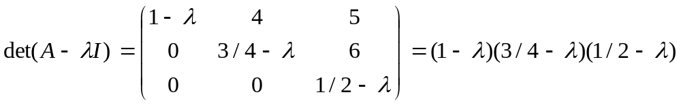

Eigenvalues & eigenvectors
(A – λI)x = 0
λ is an eigenvalue iff det(A – λI) = 0
Example:

Slide 32
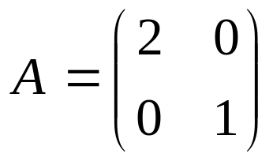
Eigenvalues & eigenvectors
Eigenvalues λ = 2, 1 with eigenvectors (1,0), (0,1)
Eigenvectors of a linear transformation A are not rotated (but will be scaled by the corresponding eigenvalue) when A is applied.
(0,1)
Av
v
(1,0)
(2,0)

Slide 33
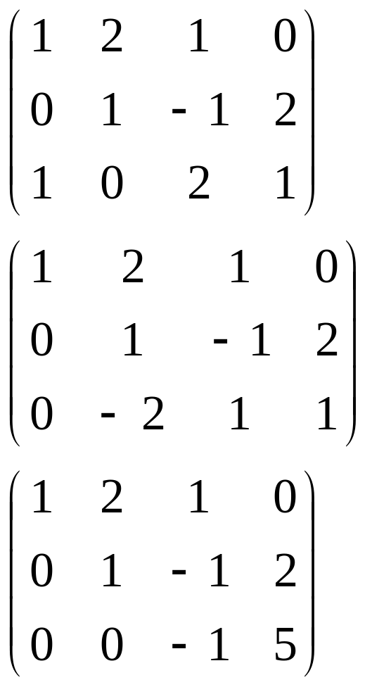
Solving Ax=b
x + 2y + z = 0
y - z = 2
x +2z= 1
-------------
x + 2y + z = 0
y - z = 2
-2y + z= 1
-------------
x + 2y + z = 0
y - z = 2
- z = 5
Write system of equations in matrix form.
Subtract first row from last row.
Add 2 copies of second row to last row.
Now solve by back-substitution: z = -5, y = 2-z = 7, x = -2y-z = -9

Slide 34
Solving Ax=b & condition numbers
Matlab: linsolve(A,b)
How stable is the solution?
If A or b are changed slightly, how much does it effect x?
The condition number c of A measures this:
c = λ_{max}/ λ_{min}
Values of c near 1 are good.

